Slide 1
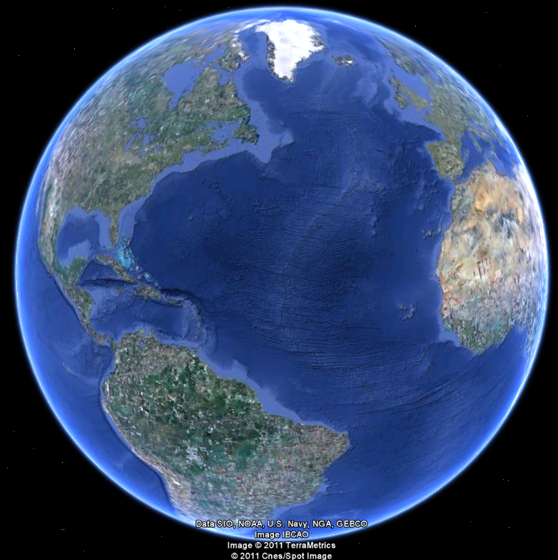
APEC 100 Sustainable Development
Resource Sustainability: A Brief Overview
Of Water, Forests, and Biodiversity:

Slide 2
Global Water “Reserves”
97.4% is ocean water
2.0% is ice cap/glacier
68.7% of Earth’s freshwater is in glaciers
If all glaciers melted, oceans would rise 200 ft.
0.6% is groundwater
0.007% lakes
0.005% soil moisture
0.0012% other
In United States
41 million acres of lakes and reservoirs
200 million acres of wetlands
2

Slide 3
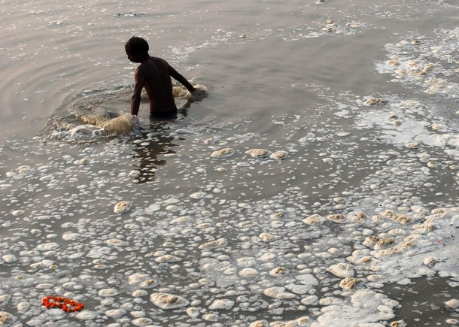
Uses and Challenges of Water Resources
Bathing, drinking, municipal water supply, navigation, irrigation, fishing, sports
Recipient of discharge of industrial effluent, municipal sewage and dumping of solid wastes.
Not only is there a limited supply of fresh water, but whatever is available is often highly polluted
Especially in the least developed countries.
Often does not meet health safety standards (if standards exist)
Notes:
Content source: “Up to their necks in it; India and pollution,” The Economist, July 29, 2008
Photo source: Daylife.com, Nov. 10, 2008 <http://www.daylife.com/photo/02gz9Ch7DvftM> July 29, 2009.

Slide 4
World Water Problems - Quantity
“The availability of useful water will likely be the biggest constraint on world population growth in the near term.” (p. 190)
By 2025, 40% of the world’s population is expected to experience water shortages
Irrigation is a key to development
Greater productivity
40% of food is grown on the 17% of cropland that is irrigated
Irrigation has been increasing (1970-1994)
4

Slide 5
Water Use in the United States
Average per capita use of freshwater is ~1,252 gallons per day
One of the highest usage in the world.
Since 1900, per capita water use increased 650%
The majority of the water comes from surface water sources rather than ground water sources.
Off-stream: Thermoelectric, agriculture, industry and mining, commercial, domestic
In-stream: Hydropower, navigation, recreation, ecosystem support
In general, all of the uses have expanded over this period
5

Slide 6
Water Quantity Challenges in India
Water resources are being overexploited by the rapid growth of the population
Content source: Barua et. al., International Journal of Ecological Economics and Statistics, 2008
Notes:
Content source: Barua and Hubacek, “Water Pollution and Economic Growth: An Environmental Kuznets Curve Analysis at the Watershed and State Level.” International Journal of Ecological Economics and Statistics, Winter 2008, Vol. 10 No. W08.

Slide 7
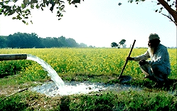
Water & Agriculture
45 million acres of US farmland is irrigated
Often, government-facilitated access to water
84% of U.S. freshwater consumption is for irrigation
15% of cropland is irrigated
In India, irrigation has been emphasized during the Green Revolution, and now accounts for over 80% of water consumption.
Ground water is diminishing, and the productivity gains in cereal production achieved in certain areas during the Green Revolution are now showing signs of decline or stagnation
Content source: Shiferaw, et. al., ICRISAT Working Paper Series no. 17
Notes:
Content source: Shiferaw, Wani and Rao. “Irrigation Investments and Groundwater Depletion in India Semi-Arid Villages: The Effect of Alternative Water Pricing Regimes,” Working Paper Series no. 17. Patancheru 502 324 Andhra Pradesh, India: ICRISAT. 24pp.
Photo Source: Reema, “A model Asian neighbor,” The Langarhall, Dec. 27 2007. <http://www.bing.com/images/search?q=India+irrigation&go=&form=QBIR&qs=n#focal=28a9e86809cfa456eda065d9930b9b83&furl=http%3A%2F%2Fthelangarhall.com%2Fwp-content%2Fuploads%2F2007%2F12%2Fbiopact_punjab_irrigation.jpg> July 29, 2009.

Slide 8
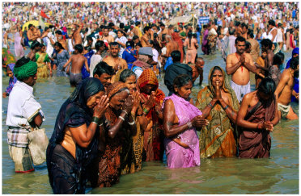
Water Quality
Rivers in India are the lifelines of the majority of people in cities, towns and villages
Most rivers are considered to be sacred
Notes:
Content source: “Up to their necks in it; India and pollution,” The Economist, July 29, 2008
Photo source: Benissen, Paul “Pilgrims Making Pura or Blessing at Sangam, Sacred Meeting Place of Three Sacred Rivers, India” Allposters.com <https://www.allposters.com/-sp/Pilgrims-Making-Pura-or-Blessing-at-Sangam-Sacred-Meeting-Place-of-Three-Sacred-Rivers-India-Posters_i3636215_.htm> July 29, 2009.

Slide 9
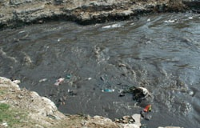
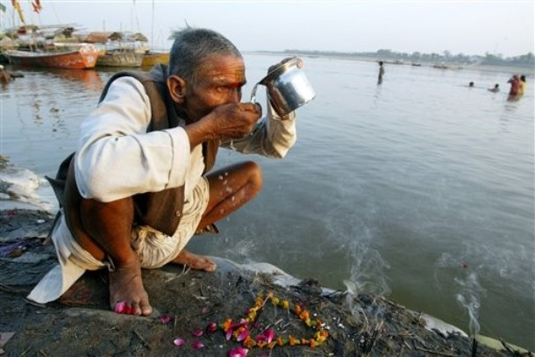
Case study: The Ganges
Rituals in the Ganges river involve bathing and drinking the water daily
Official standards: water containing more than 500 fecal coliform bacteria per 100ml is considered unsafe for bathing
The Ganges contains 60,000 bacteria per 100ml
Consuming this water has the potential to cause typhoid, polio, and jaundice, among other water borne ailments
Daylife.com
“Up to their necks in it; India and pollution,” The Economist, July 29, 2008
Notes:
Content source: “Up to their necks in it; India and pollution,” The Economist, July 29, 2008
Photo source: “Reporters Notebook: The Rape of Ganga,” Independent Broadcasting Associates, Inc. 2007 <http://www.ibaradio.org/India/ganga/radio/radio2/sd1.htm> July 29, 2009.
Photo source: Daylife.com, AP Photo, March 22, 2007 <http://www.daylife.com/photo/09FUeS2aRIdXr> July 29, 2009.

Slide 10
Point vs. Nonpoint Sources
Point sources
“Discharge pollutants directly into surface waters from a conveyance”
Municipal sewage (see figure on p. 215 of text), industrial facilities, sewer overflows
Nonpoint sources
“Deliver pollutants to surface waters from diffuse origins”
Urban runoff, agricultural runoff, atmospheric deposition
10

Slide 11
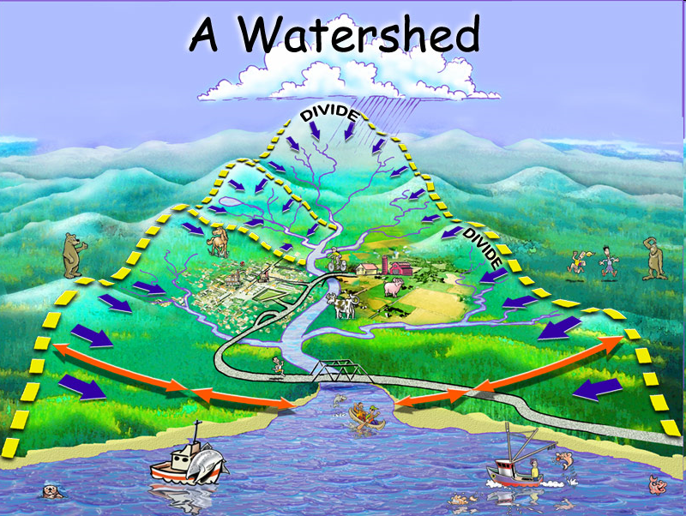
Watershed Management
Reduce floods
Ensure water quality
Increase water yields
Alter timing of water yields
Control and prevent erosion
(Figure 7.4 -water runoff and soil loss)
Bare ground: 75% of rainfall runs off and 6000 kg/ha of soil is lost
Sodgrass: 45% of rainfall runs off and 1400 kg/ha of soil is lost
Bunchgrass: 24% of rainfall runs off and 200 kg/ha of soil is lost

Slide 12
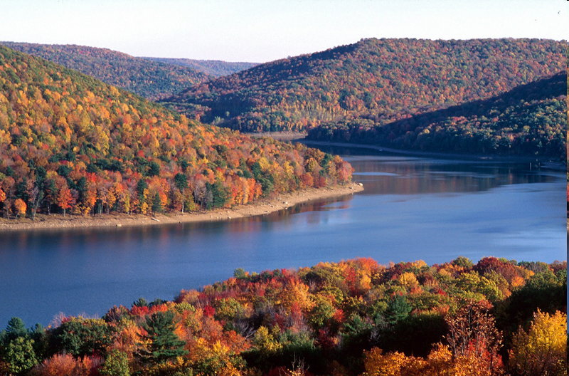
Forest Lands & Biodiversity

Slide 13
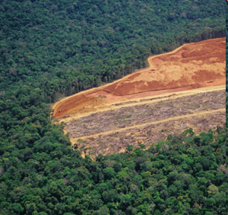
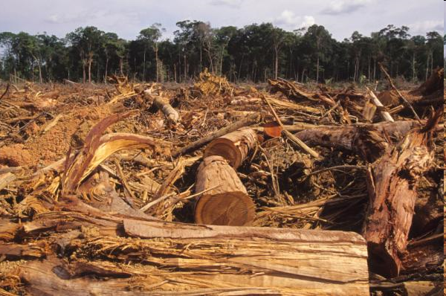
Issues in Sustainable Forestry
Rainforest destruction
Logging on public lands
Fire
Road building
Threats
Urban encroachment
Forest species in decline
Deforestation (1/2 of forests are gone)
Pollution
13

Slide 14
Forest Management: Goals
Provide a wide range of forest goods
Manage landscapes (not simply stands)
Cannot manage for wood products while entirely neglecting other ecosystem resources
Challenges
How to manage sustainably while meeting growing demand for forest goods?
14

Slide 15
Forest Land Cover in the U.S.
Forest (defined as land with 10% minimum cover)
737 million acres (33% of U.S.)
In 1600, 49% of U.S.
307 million acres converted, primarily to agriculture
What is the relationship between agricultural land use and forest land use? An example:
In 1920, 732 million acres
In 1938, 760 million acres
15

Slide 16
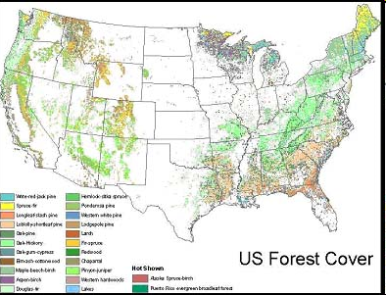

Slide 17
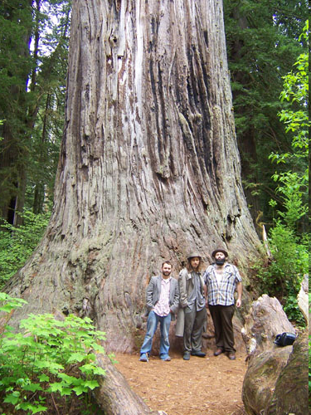
Timberland
Timberland is a subcategory of forestland
Produces 20 ft³ per acre per year of industrial wood
Pacific Northwest—capable of 120 ft³ per acre per year
Timber harvest is allowed in Forest Service Land (not reserved)
Only 6% of U.S. forest areas are wilderness and parks where commercial timber production is not allowed
2/3rds of forest areas in the U.S. are timberland (490 million acres)
Timberland area has declined 4% since 1952
Mostly, because of conversion to reserved area
Also due to housing developments
Not due to conversion to agriculture

Slide 18
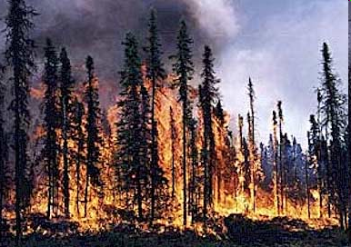

Forest Protection
Forest fire
Fire suppression programs began in 1900s
Issues associated with fire suppression?
Insects
Defoliators, sapsuckers, feeders
Disease
Fungi, bacteria, viruses
Abiotic factors
Air pollution
18

Slide 19
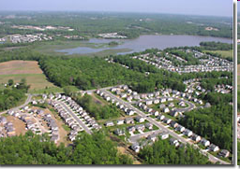
Forest Management - The Need for Change
Vocal opposition to forest management practices since the 1970s. Due to the following concerns:
Clear cutting
Inadequate attention to slopes and soils
Erosion concerns and lack of flood prevention
Fragmentation of forests due to:
Cuttings
House development
Loss of old growth forest in Pacific NW
Endangered species conflicts
Forestry a responsibility of US Department of Agriculture or the US Department of Interior?
19

Slide 20
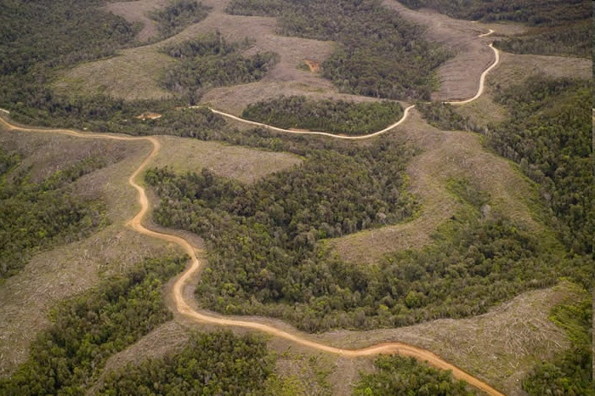
Clear Cutting of Forests
65% of U.S. timber is harvested by clear cutting
Advantages
Tends to be a lower-cost way of harvesting
Less road building
More efficient reseeding
Shorter time to regenerate a stand
More effective removal of damaged stand (fire, insect, storm)
Improved game habitat
Disadvantages
Replaces diverse, uneven-aged areas with single species stands
Increases susceptibility to fire, disease, insects
Poor habitat for most wildlife
Soil erosion, flooding, landslides, soil compaction
20

Slide 21
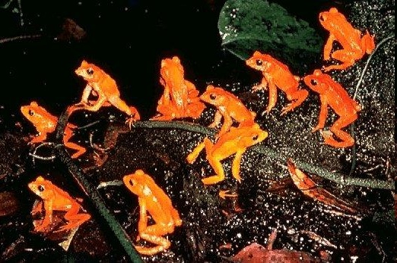
Biodiversity
5 -10 million species estimated.
2 million species named.
Extinction
During the last 100 years, about 5 species per year are known to have become extinct
Book: Present trends → Many 1,000s or 1,000,000s will go extinct during the 21st century
Salmon example
250 years ago, estimated 500,000 salmon migrated in 34 New England river systems
Now, 7,000 in 16 river systems
Golden Toads in Monteverde,
Costa Rica (1989)

Slide 22
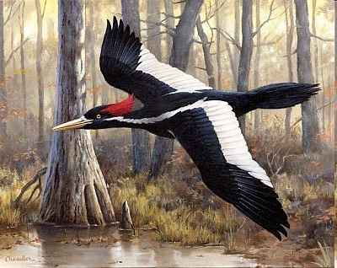
Loss of Biodiversity
Human action has accelerated the rate of extinction of animal and plant species
In the past, extinctions are natural phenomena
Rate has increased
50% of species are in tropical areas
Less than 10% of land area
Currently, under high threat by population growth
Consideration: Are protecting species only a good that wealthy countries can afford?
Is concern for biodiversity elitist?

Slide 23
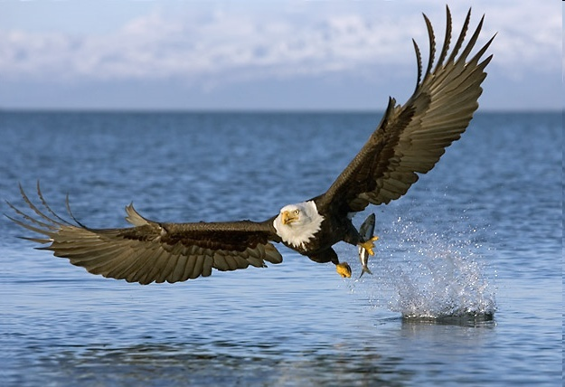
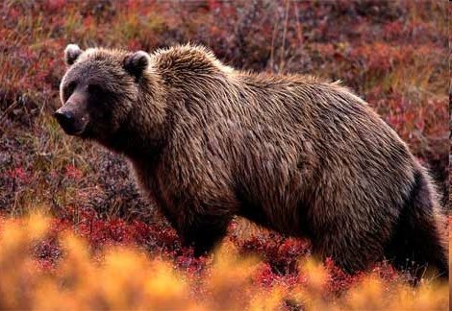
Endangered Species Policy
The Endangered Species Act (ESA) 1973
Endangered: “Any species in danger of extinction throughout all or a significant portion of its range” other than insect pests
Threatened: “Likely to be endangered in the foreseeable future”
Administered by Fish and Wildlife Service and National Marine Fisheries Service
Endangered species listings
1991
651 listed as threatened or endangered
600 serious candidates
3000 potentially eligible
1998
349 animals
553 plants
233 others are threatened
8 removals; 18 upgrades
International Union for Conservation of Nature and Natural Resources
In 1996, 5,205 species “threatened with extinction”

Slide 24
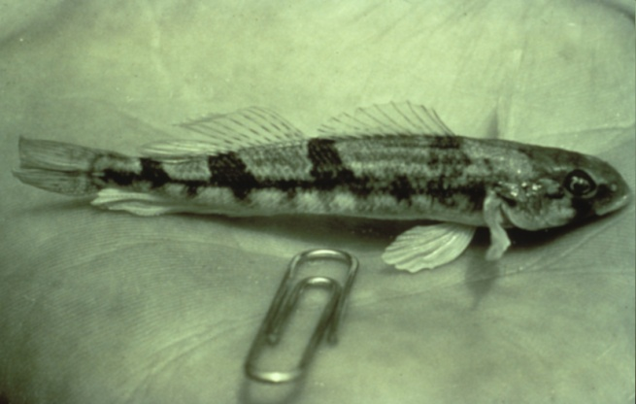
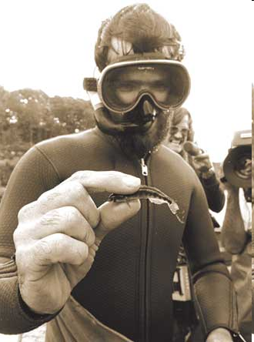
Endangered Species Act (1973)
Prohibits government agencies from authorizing, funding, or carrying out any activities that might harm an endangered species or it habitat
Prohibits private individual from “taking” an endangered species
Taken means virtually any activity leading to harm
Habitat Conservation Plans—1982 Amendment allows the landowner of critical habitat to develop a plan (approved by FWS) in exchange for an incidental take permit
ESA and previous protection efforts
Continues land purchase
Abandons “practicability” of benefit and cost analysis.
The Snail Darter

